Slide 1
Alhazen Image ForensicS System
Group members
Supervisor
Bilal Fawad Khan – F-18-BCSE-007
Humna Hayee – F-18-BCSE-014
Raheel Kiany – F-18-BCSE-161
Syed Abis Abbas Zaidi – F-18-BCSE-169
Dr. Muhammad Ishtiaq

Slide 2
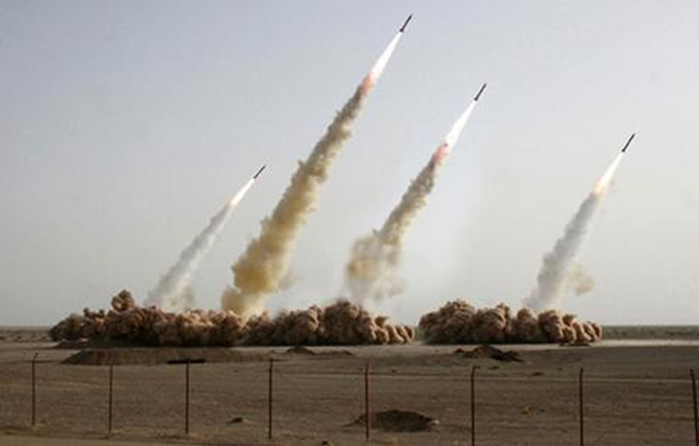
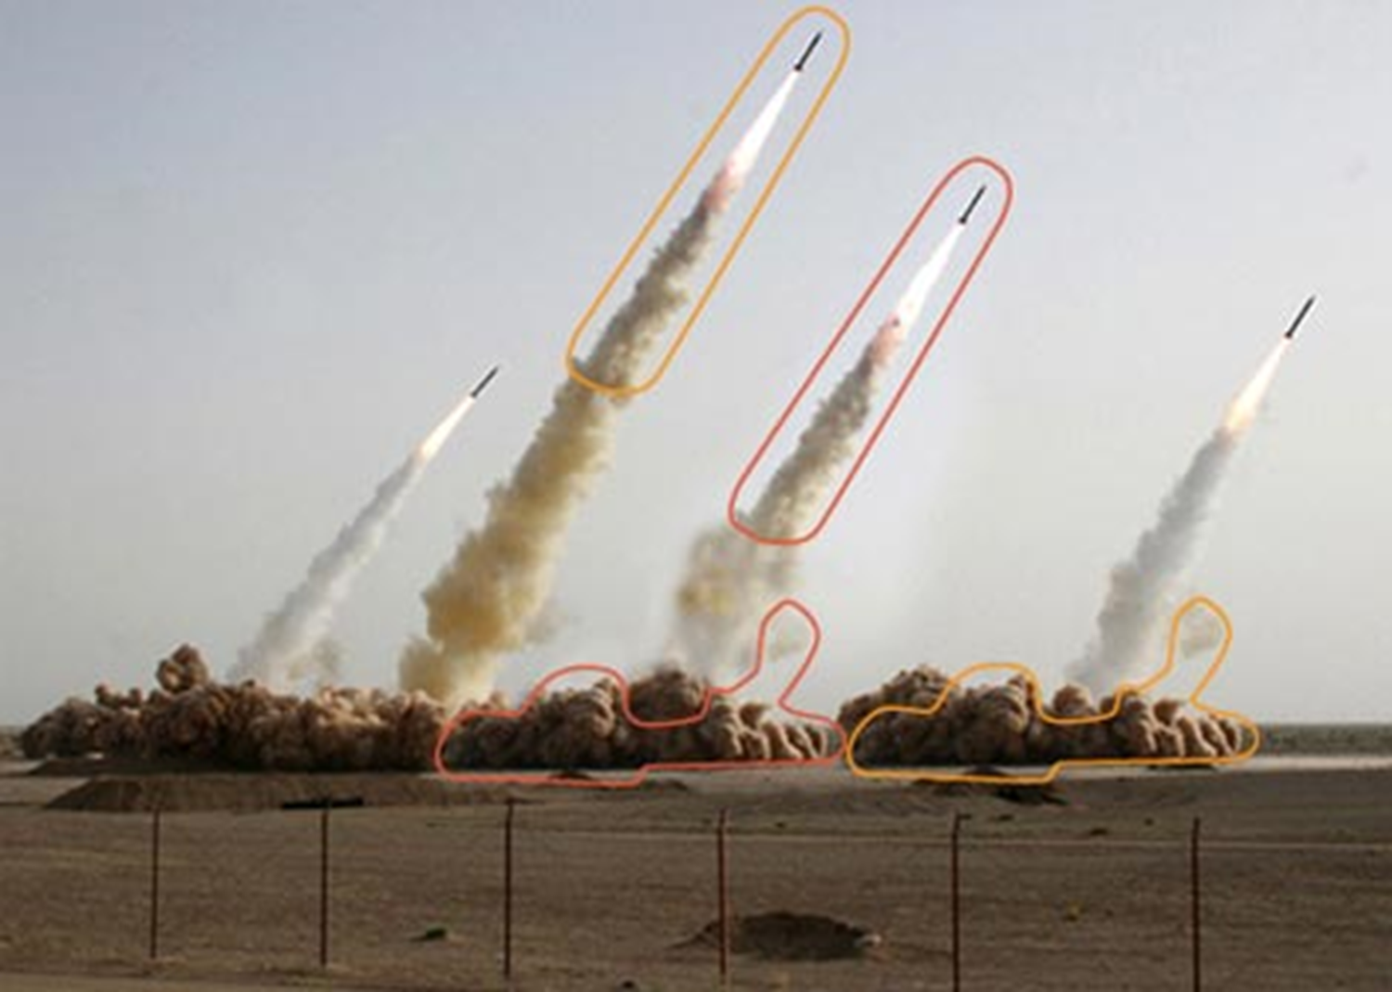
Introduction
Image speak louder then words
People believe images as an evidence
Judgement and decisions are made on the basis of images
More value is given to visual proof rather than mere words
But what if that image is FAKE?!
People do believe what is present in the image is truth, but what if that’s not the case?!

Slide 3
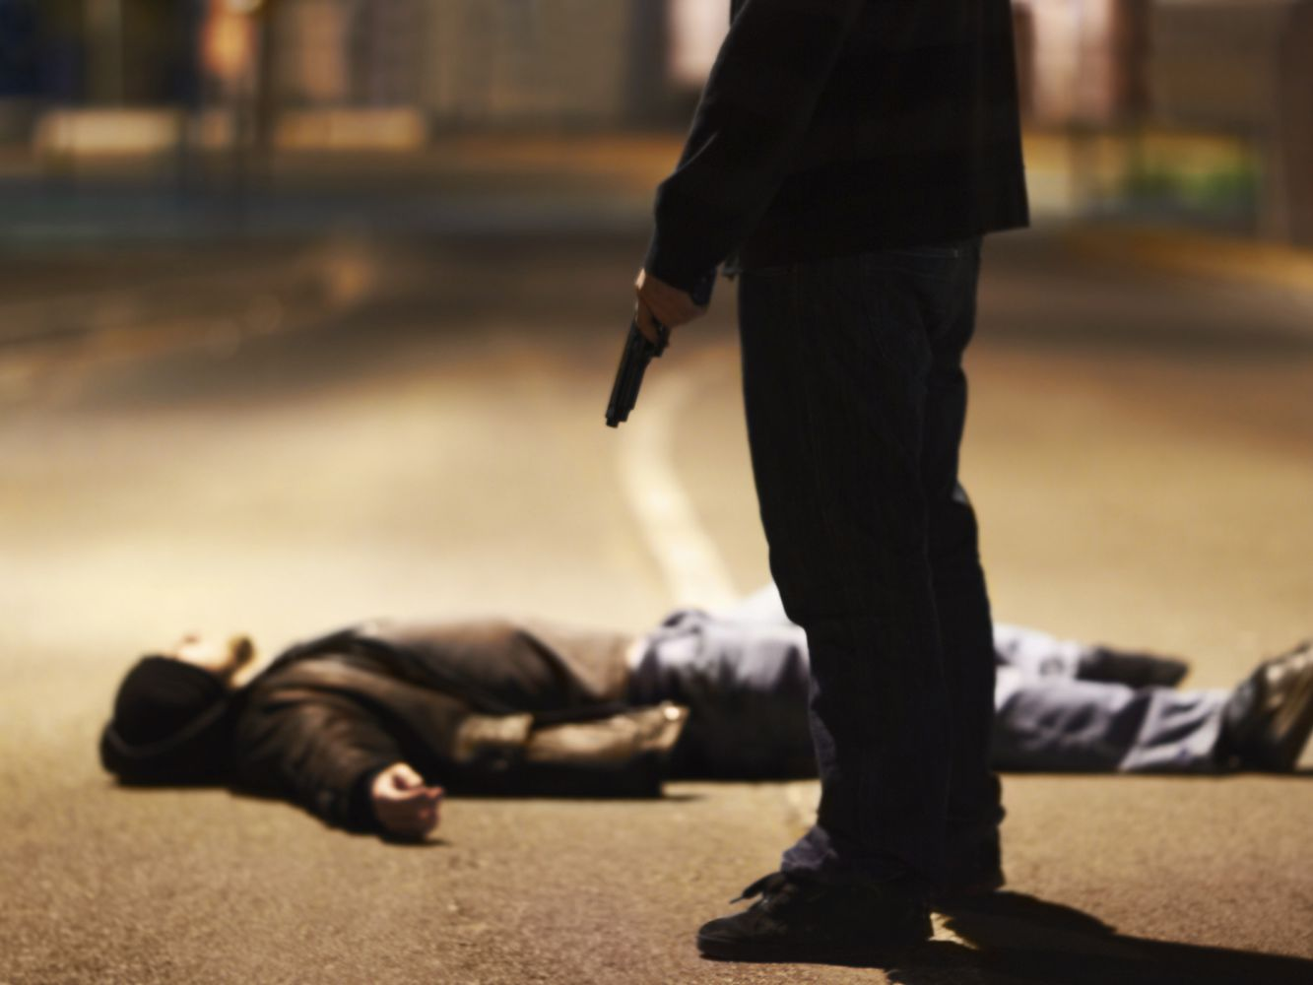
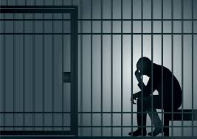
Problem Statement
There is a picture of a person who is innocent, but he is accused of murder and only evidence is in the form of an image, but he denies that by saying that he has been framed into it, the image has been edited by someone.
This situation might be different sometimes as a criminal might get away with a crime by providing an image that proves him innocent in front of judge.
Judiciary system in country lacks practical digital media forensic system.
To find either someone is guilty or not we need to detect that image for that we need a image forensic system.
From politicians to celebrities, everyone has been involved in rumors with digital media having questionable authenticity.

Slide 4

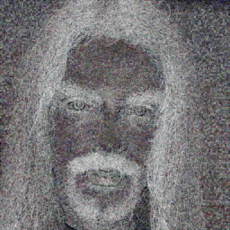
Proposed Solution
We are aiming to develop a research [1] based image forensic system.
Our proposed system will be able to perform forensic image analysis to preliminarily detect forgery in an image.
The system will use image forensic algorithms to identify and give results on
The System will be able to detect forgeries irrespective of the image format.

Slide 5
Feature List
Image will be uploaded to the system by the user.
Image analysis by the system to display Metadata which includes image Resolution , creation date etc.
Image analysis by the system to display of visual data such as color composition, color saturation, contrast and image clarity etc.
Preliminary forgery checks (to check whether for any signs of forgery in the image).
Prompt user for a specific forgery check technique and apply the desired check.
Visually display the outcome and composition of each forgery detection technique using graphical elements (pie charts and histograms etc.).
Process multiple images in batch to perform analysis, generate reports to view them or to save them.

Slide 6
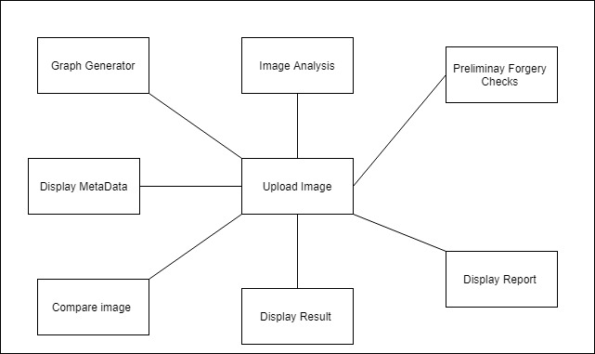
Block Diagram

Slide 7
Functional Requirement
The system should be able to analyze the image/images uploaded by the user.
The system should be able to perform metadata analysis on the uploaded images
The system will display visual data such as color composition, color saturation, contrast, and image clarity.
The system should perform preliminary forgery checks.
The system will visually display the output from the results of forgery detection using graphical elements such as pie charts and histograms.
The system should be able to process multiple images in a batch to perform analysis.
The system will generate a report of the processed images

Slide 8
Tools and Technology Used
IDE (Integrated development environment)
Visual Studio
PyCharm
OS (Operating System)
Windows 10
Programming Language(s)
Python
Design Tools
InVision Studio
Diagrams.net (previously Draw.io)
Utility Software
MS Office

Slide 9
Potential Impact on Society
The national and provincial FSAs (Forensic Science Agencies) were established within last 5-6 years with no forensic facility existing in the province of Sindh and Balochistan. [2]
This emerging domain is at primitive state across world and yet to be introduced in Pakistan.
The Development of this system will make it one of the First Image Forensic System in Pakistan
As it is said that: “The first step is always the hardest” so our system will pave a way in the development of the image forensic domain on academic level in Pakistan.

Slide 10
References
https://openaccess.thecvf.com/content_CVPR_2019/papers/Wu_ManTra-Net_Manipulation_Tracing_Network_for_Detection_and_Localization_of_Image_CVPR_2019_paper.pdf
https://ejfs.springeropen.com/articles/10.1186/s41935-018-0077-3

